Slide 1
Heteroassociative Memory

Slide 2
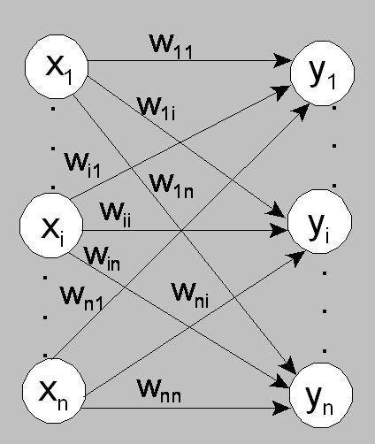
Introduction
Auto associative Memory
Hetero associative Memory
Architecture:

Slide 3
Auto Associative Memory
The inputs and output vectors s and t are the same.
The Hebb rule is used as a learning algorithm or calculate the weight matrix by summing the outer products of each input-output pair.
The autoassociative application algorithm is used to test the algorithm

Slide 4
Hetero Associative Memory
The inputs and output vectors s and t are different.
The Hebb or delta rule is used as a learning algorithm or calculate the weight matrix by summing the outer products of each input-output pair.
The heteroassociative application algorithm is used to simplified the pattern the algorithm.

Slide 5
Review
Heb Rule:
Simple learning algorithm
Update weight (W) is performed by:
$$w_{i}^{new}=w_{i}^{old}+x_{i}∗y$$
where x_{i} is the i-th input and y is the target

Slide 6
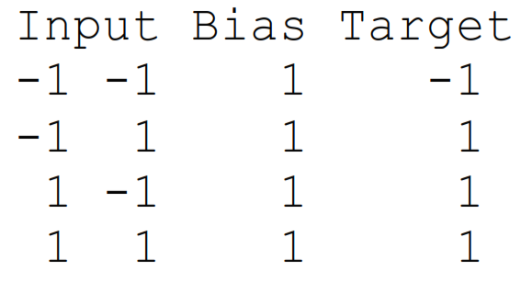
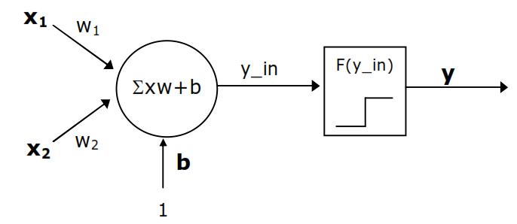
Example
Given the data:
Performed the learning using Heb rule for NN:

Slide 7
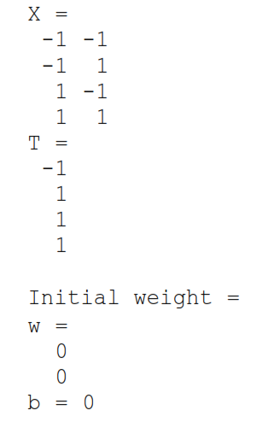
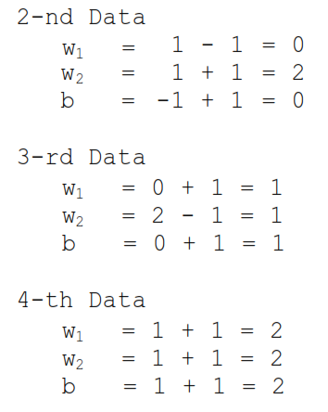
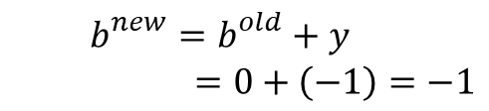
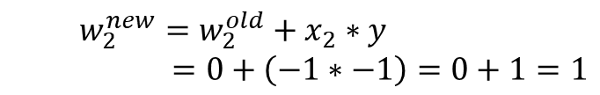

Learning Step
Update weight:
1-st data:
$$w_{1}^{new}=w_{1}^{old}+x_{1}∗y$$
$=0+\left(−1∗−1\right)=0+1=1$
$$w_{2}^{new}=w_{2}^{old}+x_{2}∗y$$
$=0+\left(−1∗−1\right)=0+1=1$
$$b_{}^{new}=b_{}^{old}+y$$
$=0+\left(−1\right)=−1$

Slide 8
Learning Step
Final weight: w₁=2, w₂=2, and b=2
Testing for input x=[-1 1]:
y_{in}=2*-1+2*1+2=2
y=f(y_{in})=1 for bipolar step function
Testing for input x=[-1 -1]:
y_{in}=2*-1+2*-1+2=-2
y=f(y_{in})=-1 for bipolar step function
The learning could achieve the target

Slide 9
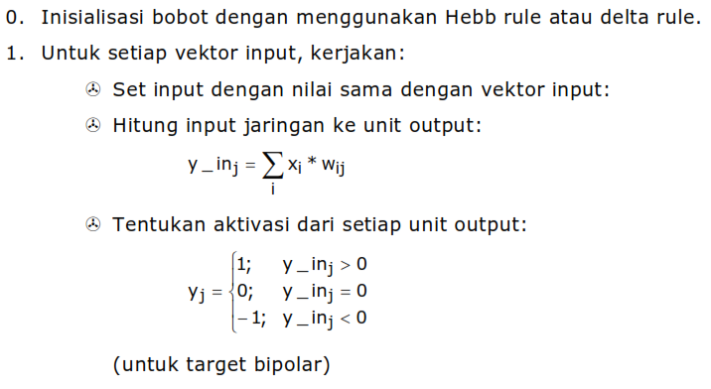
Algorithm

Slide 10
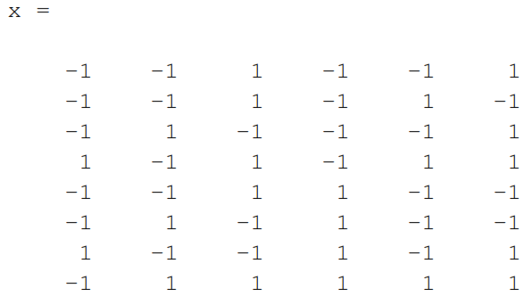
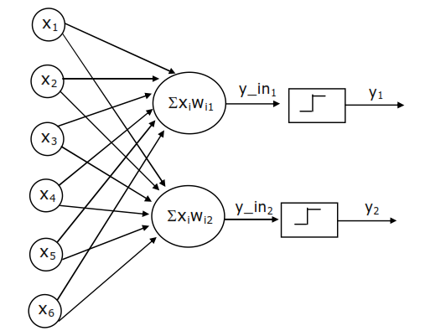
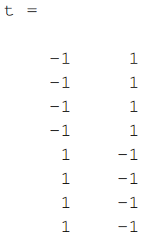
Example
Use this architecture to find the weights which can map the given input into the target

Slide 11
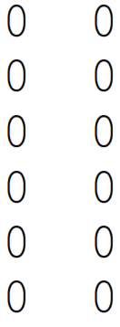
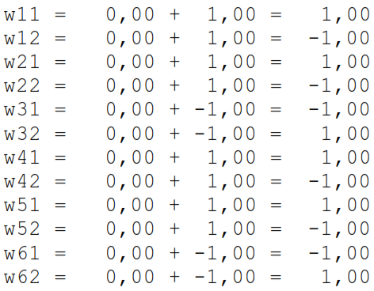
1. Initialization
W₀=
2. Training process using Heb:
1st-Data input: [-1 -1 1 -1 -1 1]

Slide 12
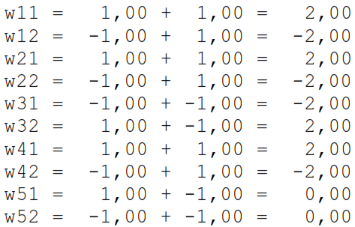

…Next…
2st-Data input : [-1 -1 1 -1 1 -1]
Do for all data input

Slide 13
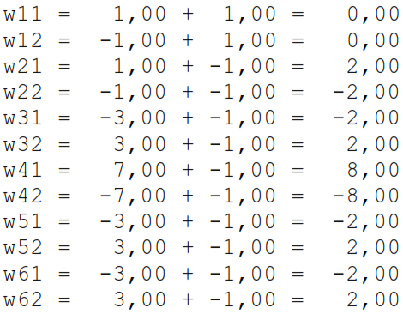
Finally
8st-Data input : [-1 1 1 1 1 1], we get:

Slide 14
Testing
Use the input data to simulate the final weight:
Xin= [-1 -1 1 -1 -1 1]
yin₁ =-12
yin₂ =12
After activation function the output:
y₁ =-1
y₂ = 1
t₁ =-1
t₂ = 1
The Same

Slide 15
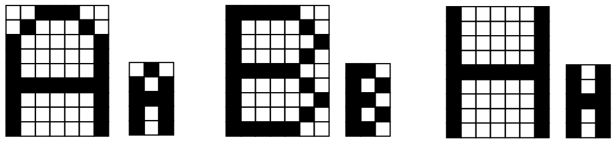
Application
Pattern mapping/matching of the following Character:
How to solve this problem?

